Slide 1
https://github.com/marianosz/netCoreWorkshop
Notes:
No better time to be a .NET developer – you have more scenarios at your finger tips than ever, using the technology you love and make you productive. You can literally build any app for any device for any platform with .NET.

Slide 2
.NET Core Workshop
Mariano Sánchez
sanchezmariano@outlook.com @marianosz
http://weblogs.asp.net/marianos

Slide 3





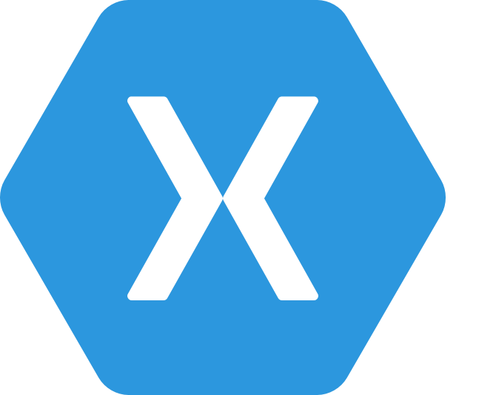
.NET Any developer, any app, any platform
iOS
OS X
Notes:
No better time to be a .NET developer – you have more scenarios at your finger tips than ever, using the technology you love and make you productive. You can literally build any app for any device for any platform with .NET.

Slide 4
Exciting times ahead for .NET
Multi-purpose, comprehensive framework for desktop and web applications
Modern DEVICE EXPERIENCE
Universal Windows platform
Unified development across Windows devices
XAMARIN
Extend your reach to any device with .NET
.NET FRAMEWORK
Modern CLOUD EXPERIENCE
.NET CORE
Cross-platform, high performance .NET
ASP.NET Core
Cloud optimized framework for micro services

Slide 5
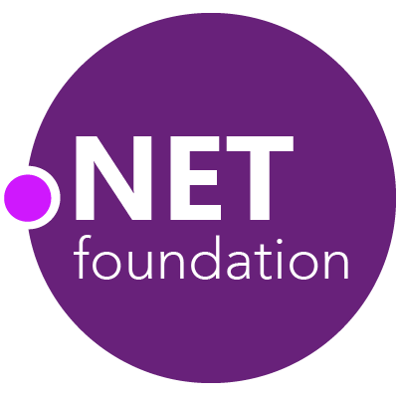



.NET Compiler Platform ("Roslyn")
MVVM Light Toolkit
MSBuild
ASP.NET MVC
IdentityManager
ASP.NET Core
MEF
.NET Core
.NET SDK for Hadoop
.NET Micro Framework
Kudu
Cecil
Mimekit
Mono
Mailkit
Xamarin.Auth
Umbraco
Cake
Open Live Writer
NuGet
WorldWide Telescope
Couchbase Lite for .NET
ASP.NET Web Pages
Microsoft Azure SDK for .NET
ASP.NET SignalR
WCF
Openness
Community
Rapid innovation
LLILC
Xamarin SDK
Entity Framework
Open XML SDK
IdentityServer
Microsoft Azure WebJobs SDK
Microsoft Web Protection Library
OWIN Authentication Middleware
Orchard CMS
ProtoBuild
ASP.NET Web API
System.Drawing
Orleans
ASP.NET AJAX Control Toolkit
Prism
Xamarin.Mobile
Salesforce Toolkits for .NET
Protection
Practices
Visibility
Support
Licenses
Copyrights
Trademarks
Patents
Mentorship
Governance
Feedback
Co-ordination
Media
Branding
Events
Hosting
Code signing
CLA Management
Swag
Notes:
Description (“what is the .NET Foundation”)
The .NET Foundation is an independent organization created to foster open development and collaboration around the growing collection of open source technologies for.NET. It will serve as a forum for commercial and community developers alike with a set of practices and processes that strengthen the future of the .NET ecosystem.
Story telling (“why the .NET Foundation”)
In 2012 we announced how some key components of .NET such as ASP.NET MVC or Entity Framework embraced a new development process that was more transparent, open, and community driven. Since then, Microsoft has received great feedback from you. Increasing our investments in .NET, while opening the process to the community has allowed .NET to innovate faster with feedback and contributions. With the .NET Foundation we want to extend this new development model to be the norm for .NET and not the exception. We want to make sure that .NET projects (both from Microsoft and from other companies and individual contributors) have a place that provides the mechanisms to promote the openness, community participation and rapid innovation to build the next generation of the .NET ecosystem.
Messaging pillars (“what are the top three things I need to know about the .NET Foundation”)
It opens the development process for .NET: The .NET Foundation brings into one common umbrella existing and new relevant open source projects for the .NET platform, such as ASP.NET, Entity Framework and the recently added .NET Compiler Platform (“Roslyn”). The .NET Foundation will provide the frame for making this the norm moving forward, so more and more components and libraries of .NET are using an open process that is transparent and welcomes your participation.
It encourages customers, partners and the broader community to participate: The .NET Foundation will foster the involvement and direct code contributions from the community, both through its board members, advisory council, technical steering group, as well as directly from individual developers, through an open and transparent governance model that strengthens the future of .NET.
It promotes innovation by a vibrant partner ecosystem and open source community: The .NET Foundation will promote commercial partners and open source developers to build solutions that leverage the platform openness to provide additional innovation to .NET developers. This includes extending .NET to other platforms, extending Visual Studio to create new experiences, providing additional tools or extending the framework and libraries with new capabilities.
Call to action: Join the conversation
We are just taking the first steps in the creation of the .NET Foundation because we want your feedback and participation from the very beginning. We are starting with a core set of participants including representatives for the .NET open source community, partners and enterprises such as Miguel de Icaza and Salesforce for example, who will collaborate to define the frame of the .NET Foundation. You can actually be part of that process too by providing feedback at dotnetfoundation.org.

Slide 6
.NET: the family gets bigger
.NET FRAMEWORK
.NET CORE
XAMARIN
Platform for .NET applications on Windows
Cross-platform and open source framework optimized for modern app needs and developer workflows
Cross-platform and open source Mono-based runtime for iOS, OS X, and Android devices
Distributed with Windows
Distributed with app
Distributed with app
Notes:
Notes: Focus on the great additions to the .NET Framework, enabling developers to target the latest applications in the cloud and devices. Explain the distribution mechanism of each. .NET Framework is distributed and available on Windows whereas .NET Core & Xamarin are distributed with the app.

Slide 7
.NET Runtimes
Full .NET CLR
Includes all APIS, and ensures backward compatibility.
.NET Core
Small (11 MB)
Composable, distributed via NuGET
Side by Side
Cross-Platform
Windows, OS X, Linux
Ryujit y .NET GC OSS

Slide 8
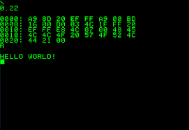
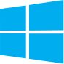


.NET Core

Slide 9
Languages
C#
Flexible, powerful, multi-purpose
Investments in C# 7: Evolve for modern patterns in distributed applications: tuples, pattern matching, others.
VB
Simple, easy to use
Investments in VB 15: Bring key language features and platforms while keeping VB simplicity principles.
F#
Elegant functional programming
Investments in .NET Core: Language updates for C# 7 / VB 15 interop, platform support and tooling updates.
Notes:
C#, Visual Basic and F# are all supported on .NET Core and can be used to create cross-platform apps that run anywhere. In addition, C# is supported in other cross-platform editors like Visual Studio Code via OmniSharp. Currently there are project templates provided C# in Visual Studio and Visual Basic templates will be added as the tooling reaches RTM (with Visual Studio NEXT).

Slide 10
Installing .NET Core
Compiling
https://github.com/dotnet/coreclr
Using Command Line
http://dot.net
Using the installer
http://dot.net

Slide 11
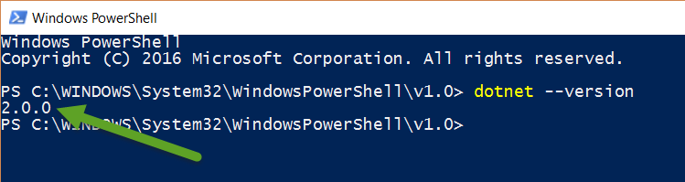
Installing .NET Core
Confirm Version:

Slide 12
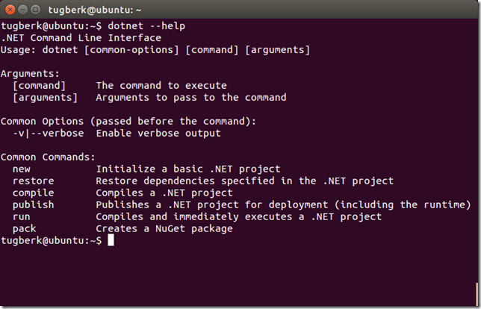
.NET Command Line Interface (CLI)
A single tool for compiling, deploying, and managing .NET applications on all platforms
Notes:
The .NET Execution Environment (DNX) is a software development kit (SDK) and runtime environment that has everything you need to build and run .NET applications for Windows, Mac and Linux. It provides a host process, CLR hosting logic and managed entry point discovery. DNX was built for running cross-platform ASP.NET Web applications, but it can run other types of .NET applications, too, such as cross-platform console apps

Slide 13
New Web Projects with dotnet
dotnet new web
Empty Hello World Project
dotnet new mvc
MVC Template
--auth Individual adds identity support
--use-local-db true uses localdb instead of SQLite
dotnet new webapi dotnet new razorpages
dotnet new angular | react | reactredux
Use --help to view options in CLI

Slide 14
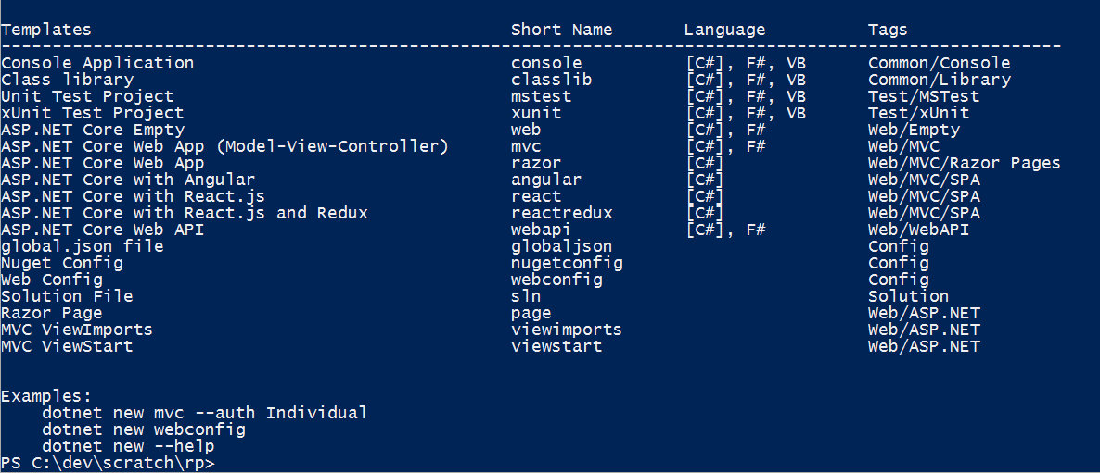
dotnet CLI Templates

Slide 15
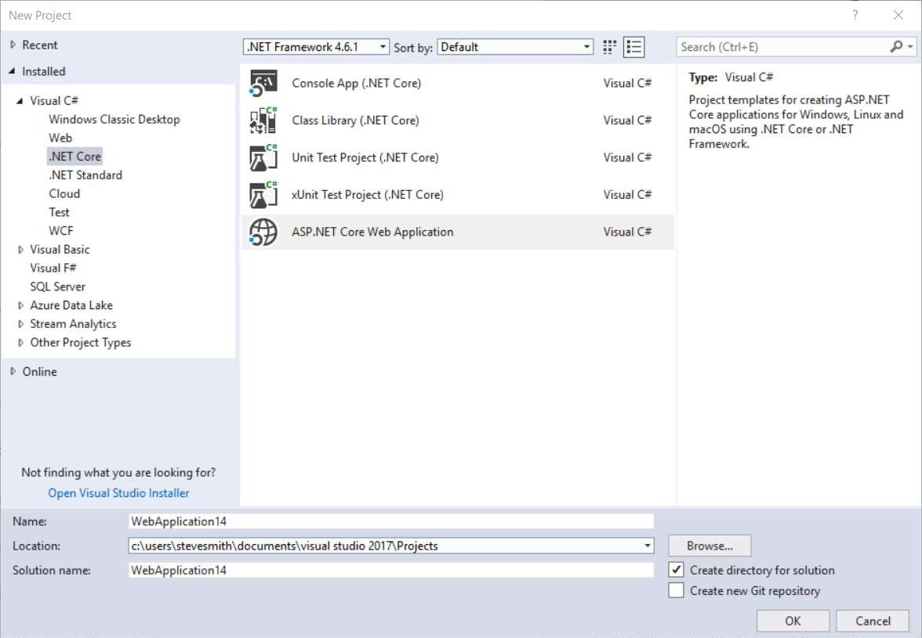
Visual Studio .NET Core Templates
Console App Class Library Unit Test xUnit Test
ASP.NET Core

Slide 16
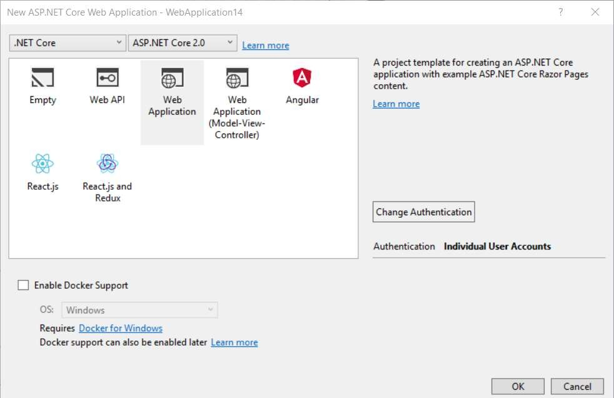
ASP.NET Core Project Templates
Empty Web API Web App
Web App (MVC) Angular
React
React and Redux
Docker

Slide 17
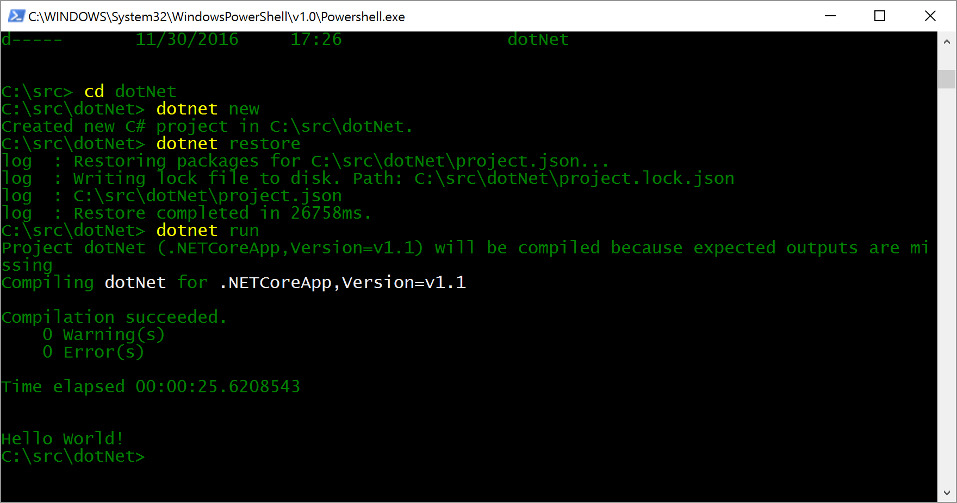
Creating and Running a .NET application

Slide 18
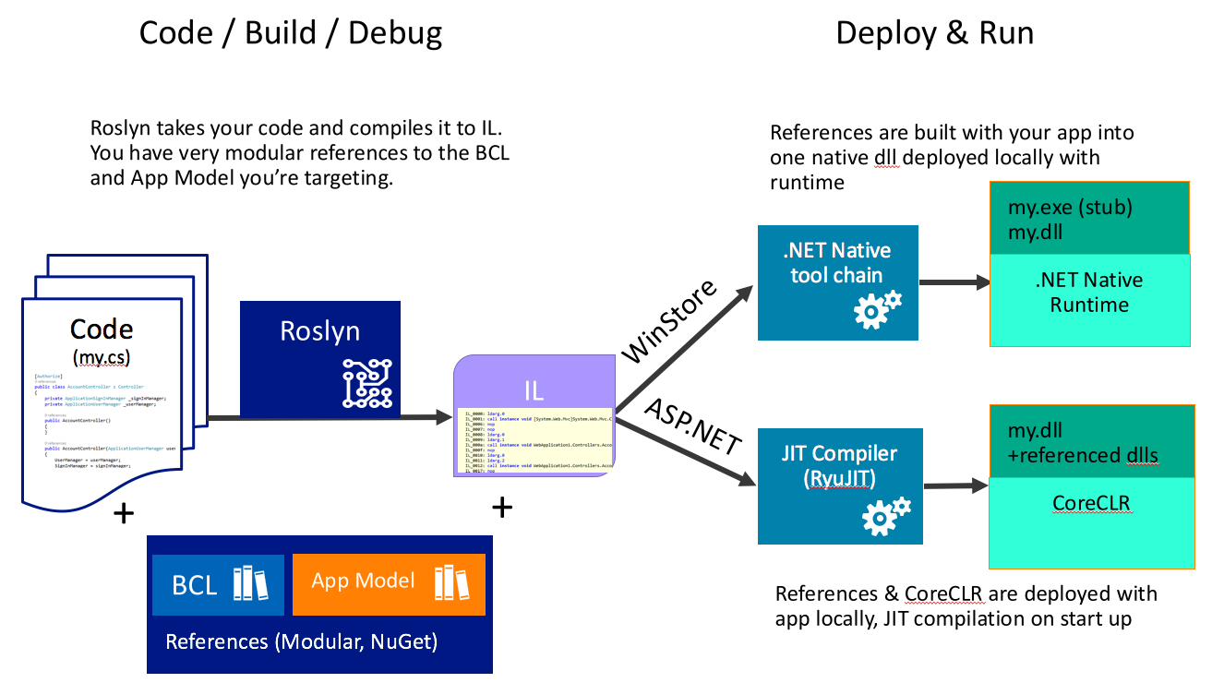

Slide 19
Development Tools
Visual Studio 2017
Visual Studio
Visual Studio Code
Visual Studio Code
Other editors: Sublime Text, Atom, etc.
Other editors: Vi, Emacs, Atom, etc.
Visual Studio Code

Slide 20
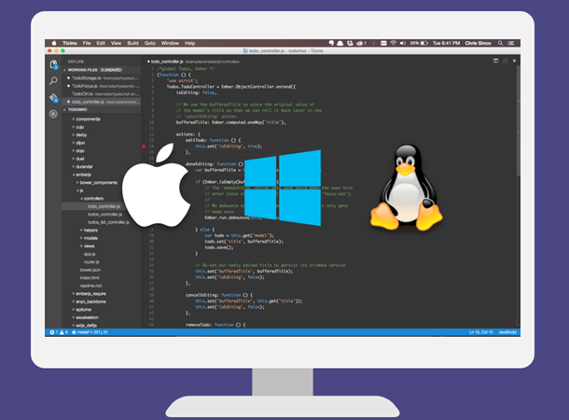
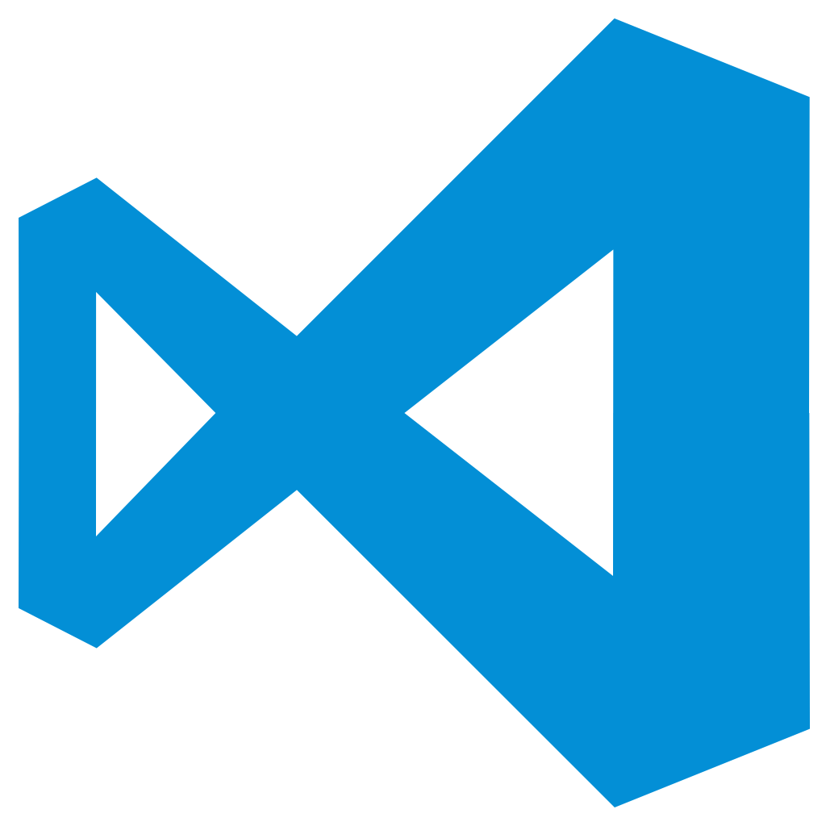
Visual Studio Code
Lightweight, cross-platform editor for Windows, OS X and Linux
Whit IntelliSense, colours, refactoring, etc.
Local editing, compilation, execution and debugging

Slide 21
Demo .NET Core

Slide 22
ASP.NET Core

Slide 23
ASP.NET Core
ASP.NET Core is a cross-platform, high-performance, open-source framework for building modern, cloud-based, Internet- connected applications.

Slide 24


ASP.NET Core and the modern web
Totally modular
Faster development cycle
Seamless transition from on-premises to cloud
Choose your editors and tool
Open source with contributions
OSS
Cross-platform
Fast

Slide 25
ASP.NET Core Stack
ASP.NET
Web API
MVC
Web Pages
Middleware
.NET CLR
.NET Core CLR
Host
IIS
Self-hosted
OS

Slide 26
ASP.NET Core Web Server Kestrel

Slide 27
Kestrel
Open source Web server for ASP.NET
It is fast and production ready.
It is not a fully featured web server.
It is recommended that you run it behind a more fully featured webserver like IIS on Windows or NGNIX on Linux.
It is run behind IIS using the ASP.NET Core Module (native IIS module).
Maps a HTTP Request to the HttpContext.

Slide 28
Kestrel in a ASP.NET Core App
Hello world!!
Request
Kestrel
Response

Slide 29
Kestrel Performance
Max of RPS Avg
3000000
2500000
2000000
1500000
1000000
500000
0
ASP.NET 4.6
ASP.NET 5
NodeJS
ASP.NET Core
Scala - Plain
Netty
IIS
WebListener
Node
Kestrel
Plain
Netty
1 - x64
1 - x86
16 - x64
16 - x86

Slide 30
ASP.NET Core Web App Key Components

Slide 31
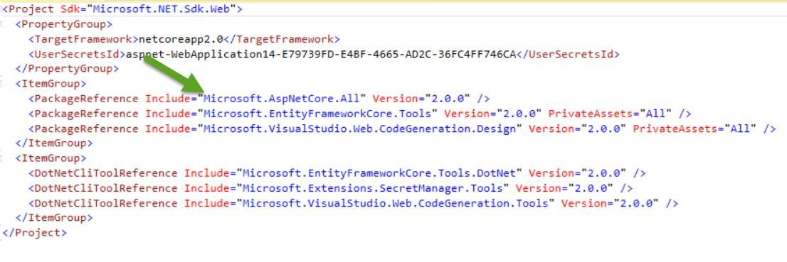
Typical Project File

Slide 32
Startup.cs
Constructor (optional)
ConfigureServices Configure

Slide 33
Startup ConfigureServices
Add framework services needed by app to services collection
Add application services to services collection
Optional
Configure Options used by app components
Configure third-party container
StructureMap, Unity, Autofac, Ninject, Castle Windsor, etc.

Slide 34
Startup.Configure
Configure the application request pipeline
Configure and arrange middleware

Slide 35
Middleware
“Middleware are software components that are assembled into an application pipeline to handle requests and responses”
Each component in the pipeline is a request delegate.
Each delegate can invoke the next component in the chain, or short-circuit, returning back up the call chain

Slide 36
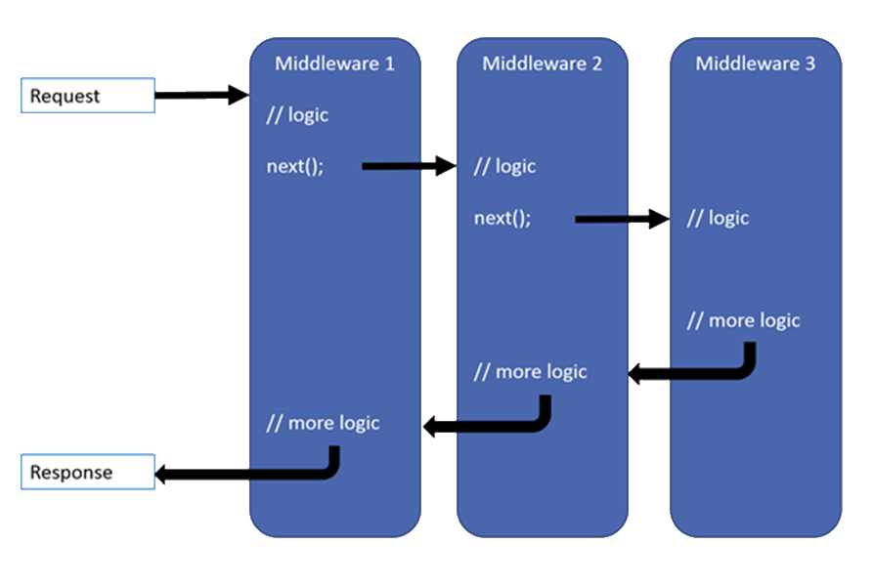
Middleware

Slide 37
Creating Middleware in Startup: Run
public void Configure(IApplicationBuilder app)
{
// app.Run terminates the pipeline without calling any later middleware app.Run(async context =>
{
await context.Response.WriteAsync("Hello, World!");
});
}

Slide 38
Creating Middleware in Startup: Use
public void Configure(IApplicationBuilder app)
{
// app.Use can execute code before and after other middleware app.Use(async (context, next) =>
{
// do some work
// call the next middleware
await next.Invoke();
// do some additional work
});
}

Slide 39
Creating Middleware in Startup: Map
public void Configure(IApplicationBuilder app)
{
// app.Map can map a path to a function app.Map(“hello”, HandleHello); app.Run(async context =>
{
await context.Response.WriteAsync(“Invalid path!");
});
}
public void HandleHello(IApplicationBuilder app)
{
app.Run(async context =>
{
await context.Response.WriteAsync(“Hello!");
}); }

Slide 40
Built-in Middleware
UseDeveloperExceptionPage
UseDatabaseErrorPage
UseExceptionHandler
UseStatusCodePages
UseAuthentication
UseStaticFiles
UseMvc

Slide 41
Kestrel + Middlewares
Request
Middleware
next()
Middleware
Middleware
next()
Kestrel
return
return
Response
return

Slide 42
ASP.NET Core MVC

Slide 43
Models, Views, and Controllers
What does MVC look like?
Request
Controller

Model

Response
View

Notes:
20486A
01: Exploring ASP.NET MVC 4

Slide 44
Controllers and Actions
Controllers are collections of actions
Useful for grouping actions into cohesive sets
Used by default for routing and URL generation (e.g. /{controllername}/{actioname})
Actions are methods that handle individual requests
Each request is routed to an action method

Slide 45
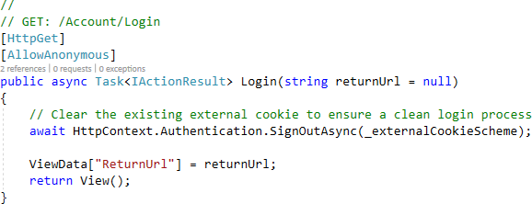
An MVC Action

Slide 46
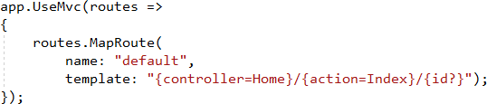
Routing to Actions
Default route specified in Startup Configure method
Attribute routing (at Controller and/or Action level)
[Route(“products/index”)]
[Route(“products/update/{id})]
[Route(“home”)] on Controller and [Route(“about”)] on Action are combined into “home/about” route

Slide 47
Attribute Routing Tips
Use default convention where possible
Define routes using attributes for non-default cases, especially for APIs APIs should use HTTP verb attributes to define routes:
[HttpGet]
[HttpGet(“{id}”)] // will combine with route specified on controller
Routes can use token replacement for [area], [controller], [action]:
[Route(“[controller]/[action]”)]
Especially powerful when used with inheritance:
[Route(“api/[controller]/[action]”)]
public abstract class BaseApiController : Controller

Slide 48
Accepting Data in Actions (Model Binding)
MVC uses model binding to convert data sent by requests into action parameters
Model binding takes place before the action is invoked
Parameters may be simple types, or complex objects
Data can come from named form values, route components, or query strings

Slide 49
Model Validation
Model types can have validation rules specified
Actions should check model validation state before making changes to application state
if(ModelState.IsValid)
Avoid using data model types for model binding
This can result in exposing more data to user changes than intended
Use [FromBody] to bind to data in the body of the request (JSON by default)
Use [BindProperty] to bind properties to non-GET requests

Slide 50
Tag Helpers
Replaces HTML Helpers (still available, but not recommended)
Render within HTML tags
Declarative, not Imperative

Slide 51
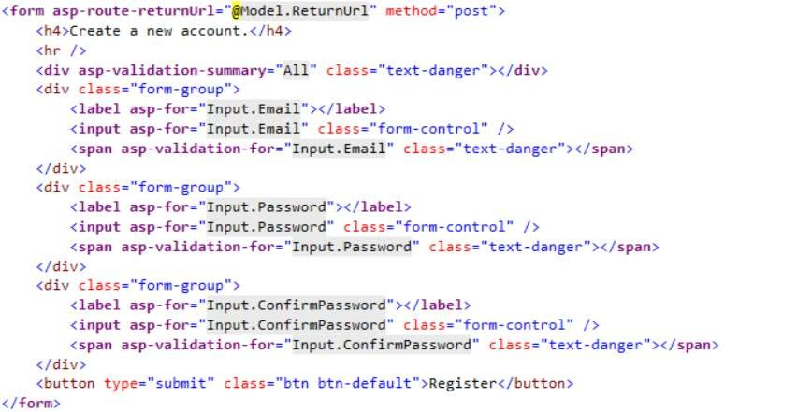
Tag Helper Example
No Cont
(Reserved fo

Slide 52
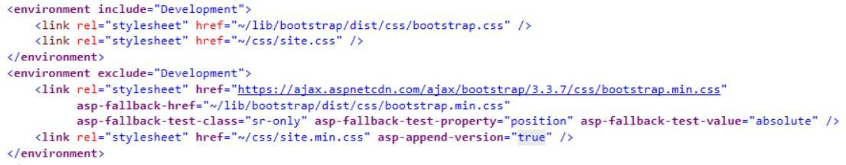
Tag Helper Example

Slide 53
Web APIs
Web API
MVC App
HTML5 App
Mobile App

Slide 54
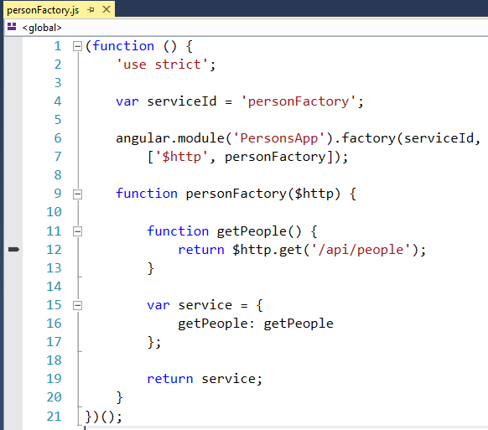
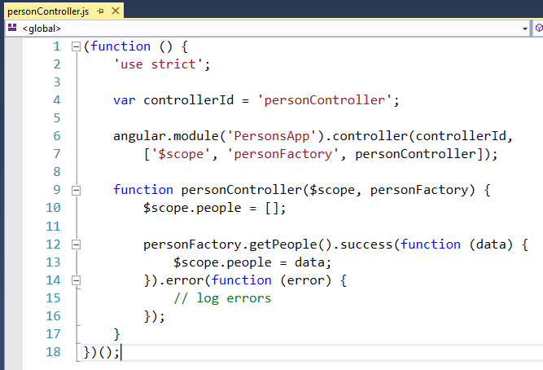
Angular App

Slide 55
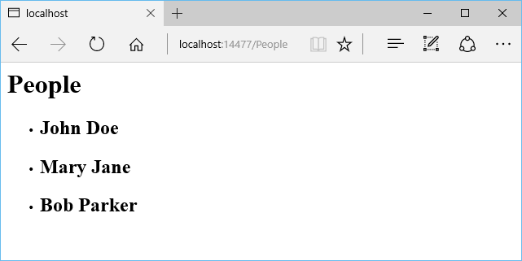
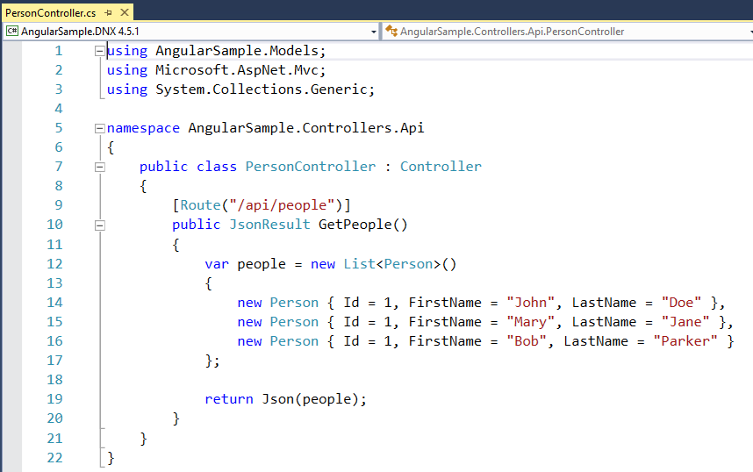
Web API Controller

Slide 56
Demo ASP.NET Core

Slide 57
Dependency Injection (DI)

Slide 58
Dependency Injection (DI)
Classes request dependencies instead of referencing directly
Dependent object instances are injected as parameters (or properties)
Allows for flexibility and modularity
Classes follow Explicit Dependencies Principle, Dependency Inversion Principle

Slide 59
Explicit Dependencies Principle
Classes should express their requirements through their constructor
Direct use of specific collaborators creates hidden dependencies
Classes with hidden dependencies aren’t “honest” about what they require
Constructor should be a contract that specifies what the class requires

Slide 60
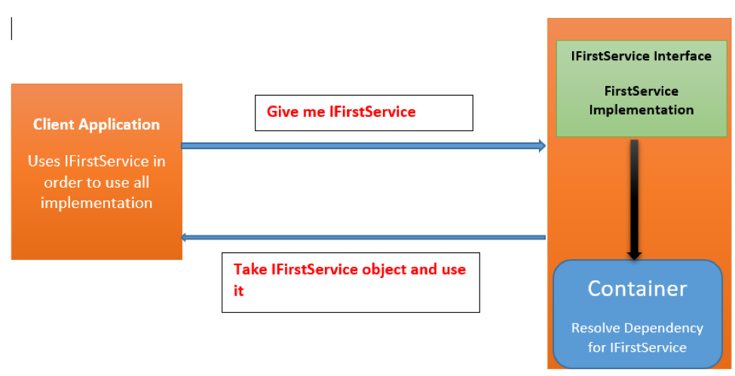
Dependency Injection on .NET Core

Slide 61
Data Access

Slide 62


Data Access
.NET Core offers providers for Data Access on different platforms:
SQL Server / Azure SQL Database
PostgreSQL
SQLite
MySQL
Oracle
No changes to the data access code
ADO.NET
Entity Framework
No data migration needed
Azure SQL Database
SQL Server
In cloud
On premise

Slide 63
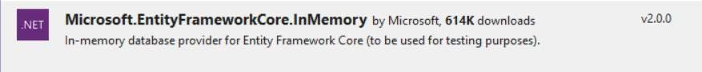
Working With a Database Using EF Core
Add Entity Framework Core (EF Core) in ConfigureServices:
Also supports InMemory – Install this package:
and modify ConfigureServices:
services.AddDbContext<AppDbContext>(options =>
options.UseInMemoryDatabase(“DbName”));
//options.UseSqlServer(Configuration.GetConnectionString("DefaultConnection")));

Slide 64
Deploy

Slide 65
Deploy
Xcopy deployment
On-premises
Azure - Windows or Linux VMs
Docker container
Windows container
You can use any of the deployment technology available on the corresponding OS (Windows / Linux / OS X)
.NET Core travels with the app
A machine-level .NET installation is not required, only the runtime.

Slide 66
Going to Production
Host my app
dotnet run?
Request
Multiple Apps on one Server?
(only one port 80)
Kestrel
My Web App
And SSL?
Response
Windows authentication?

Slide 67
Going to Production
Run it with a
reverse proxy
:80/:443
:5000
IIS – nginx – apache
IIS
Kestrel
Install ASP.NET Core Module first
My Web App
nginx
Apache

Slide 68
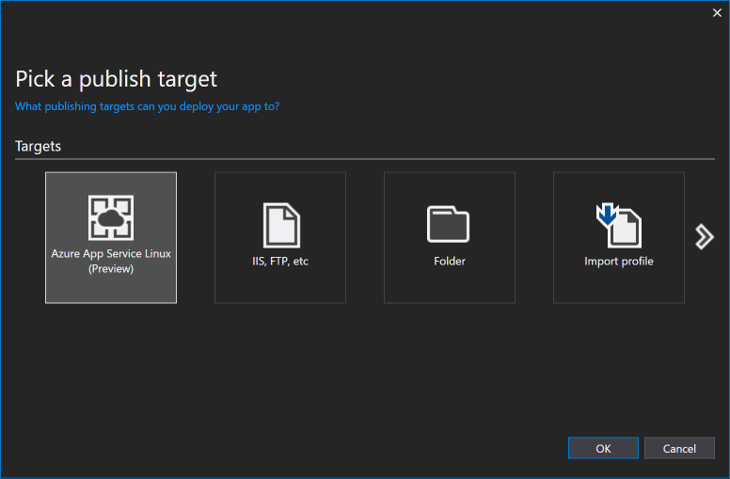
Linux VM / Docker on Azure
Deploy on Linux VM / Containers
.NET Core
ASP.NET Core

Slide 69
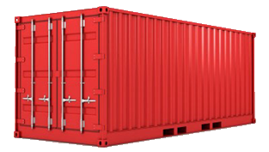
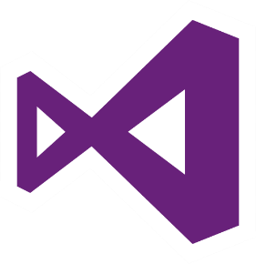


Docker
Docker is the most popular container technology
Azure provides supports for Docker containers
Visual Studio provides support for debugging, publishing, and managing Docker containers

Slide 70
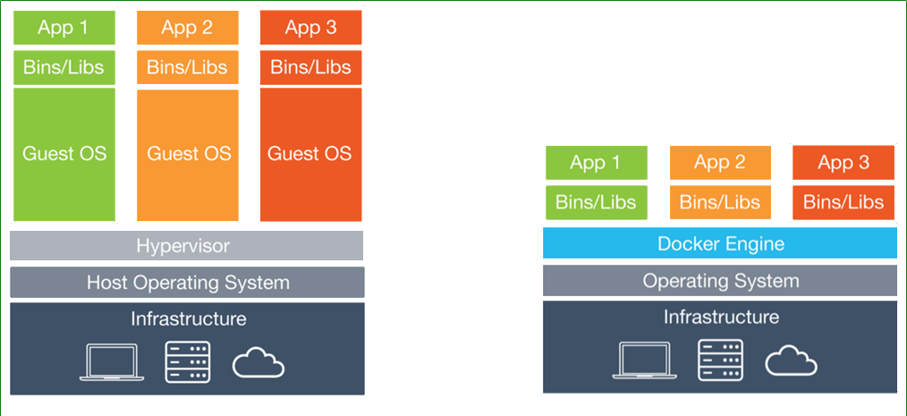
Software Containers (simplified)
A container is a "lightweight virtual machine"
Virtual Machines
Containers

Slide 71
Demo Deploy & Docker

Slide 72
Native API calls from .NET on Linux
[DllImport("libc")]
private static extern int printf(string format);
…
printf("Hello, World\n");
// Same as Platform Invoke for Windows

Slide 73
.NET
.NET FRAMEWORK
.NET CORE
XAMARIN
WPF
Windows Forms
UWP
iOS
Android
ASP.NET
ASP.NET Core
OS X
.NET STANDARD LIBRARY
One library to rule them all
COMMON INFRASTRUCTURE
Compilers
Languages
Runtime components
Notes:
Notes: Please welcome the .NET Standard Library [explain details]
As we move into the future we want to make it much easier for .NET developers to write their code once and be able to execute across .NET implementations, whether that’s .NET Framework, .NET Core, or Mono/Xamarin. To this end, we will continue to evolve and expand the .NET Standard into a set of APIs that are shared broadly across frameworks and application models. This will provide our ecosystem with much more explosive growth with libraries that can shared much more easily.

Slide 74
.NET Standard
.NET Standard is a specification that represents a set of APIs that all .NET platforms have to implement.
This unifies the .NET platforms and prevents future fragmentation.

Slide 75
¿Preguntas?

Slide 76
¡ Gracias!
Mariano Sánchez
sanchezmariano@outlook.com @marianosz
http://weblogs.asp.net/marianos

